Slide 1



SOLAX POWER
EV Charger
Solution
19 April 2023 webinar

Slide 2
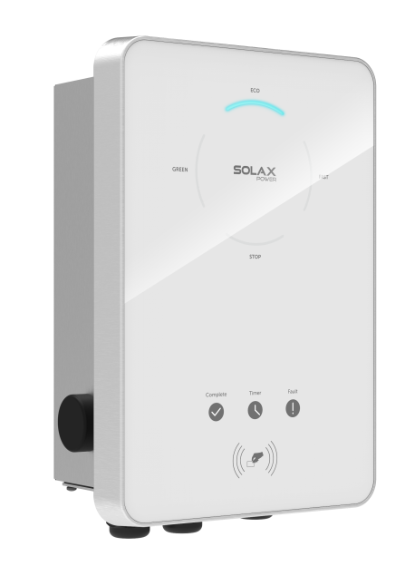
Solution Overview
Cable Connection
System Setting
Installation Tips
TABLE OF CONTENT

Slide 3

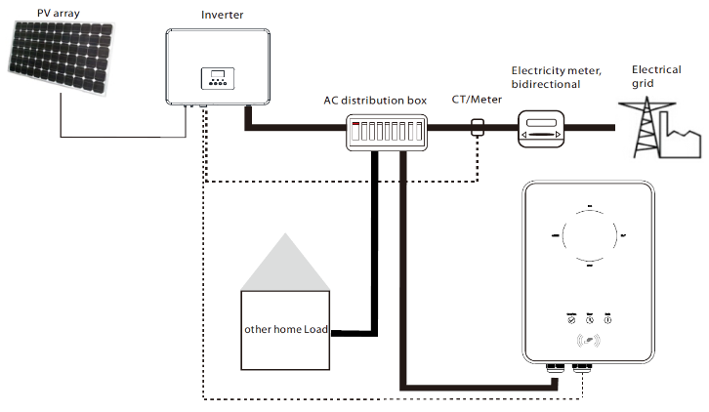
1. Solution Overview
02
EV Charger Solution
Meter and EV charger are both connected to the inverter, the inverter must be a SolaX inverter. With this construction, it is possible to do 0 export control and inverter can do smart control to the EV charger.
Moreover on the inverter it can set whether allow the battery to discharge to the EV charger (if the inverter supports battery connection).
There is a list of SolaX supported devices for connecting the EV charger in this way.
Home Use with Inverter

Slide 4
1. Solution Overview
02
Home use with Inverter
EV Charger Solution
Support list for inverters:
X1-Hybrid G4
X3-Hybrid G4
X3-PRO G2
X3-MIC G2
X1-Mini G3/G4
X1-Boost G3/G4

Slide 5
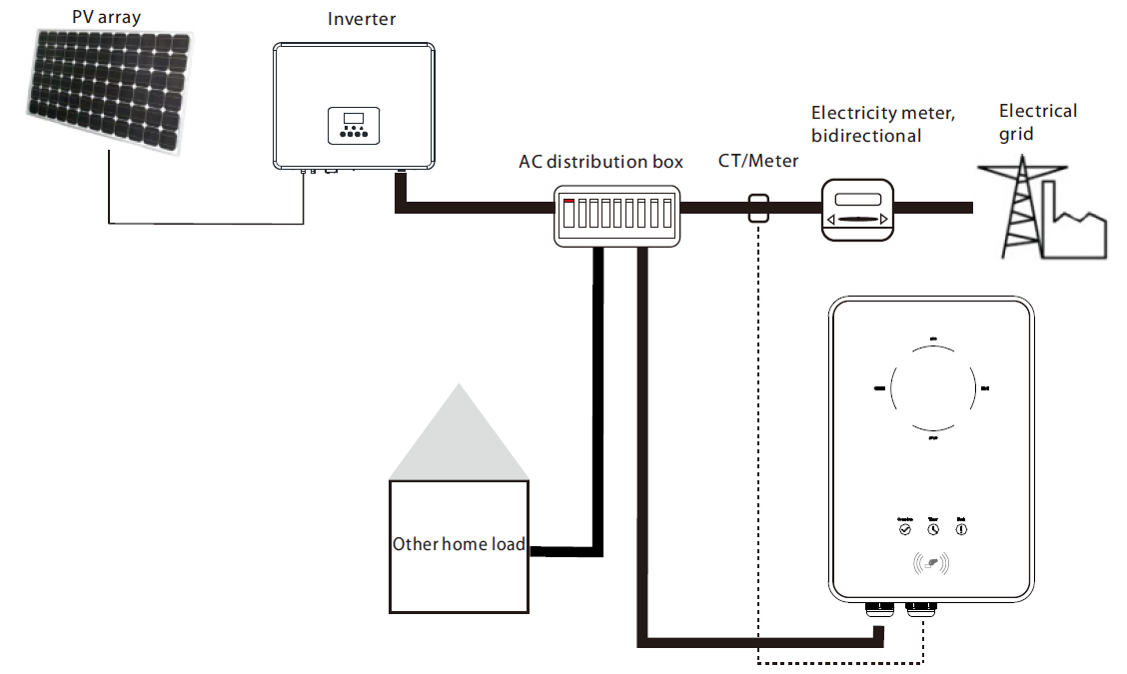
1. Solution Overview
02
Home Use Standalone
EV Charger Solution
The EV charger serves as a general load to the system, meter/CT on the grid side is connected to the EV charger directly, the inverter can be any brand.
By reading the power flow from the meter/CT, the EV charger can maximize the use of solar energy.

Slide 6
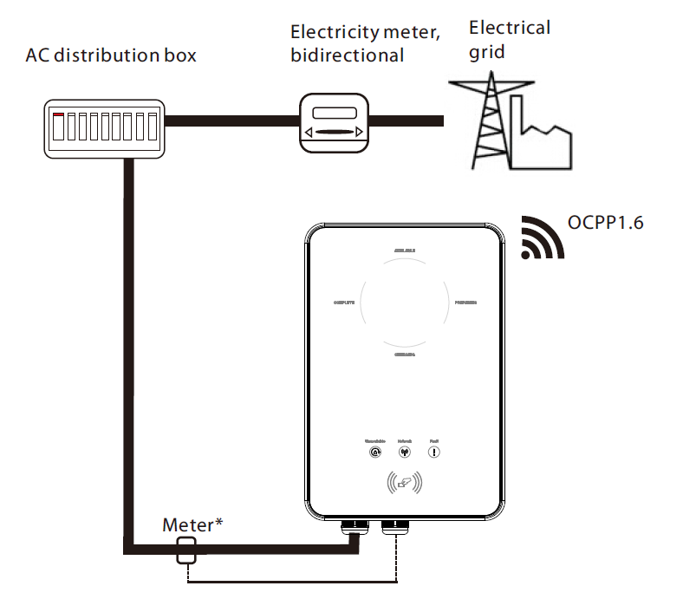
1. Solution Overview
02
Commercial Use
EV Charger Solution
Commercial edition EV charger can be connected to third party OCPP 1.6 platforms and follow the control of the platform.
Currently Solax doesn’t have a OCPP platform, if the clients have such kind of integration requirements please contact our engineer for more information.

Slide 7
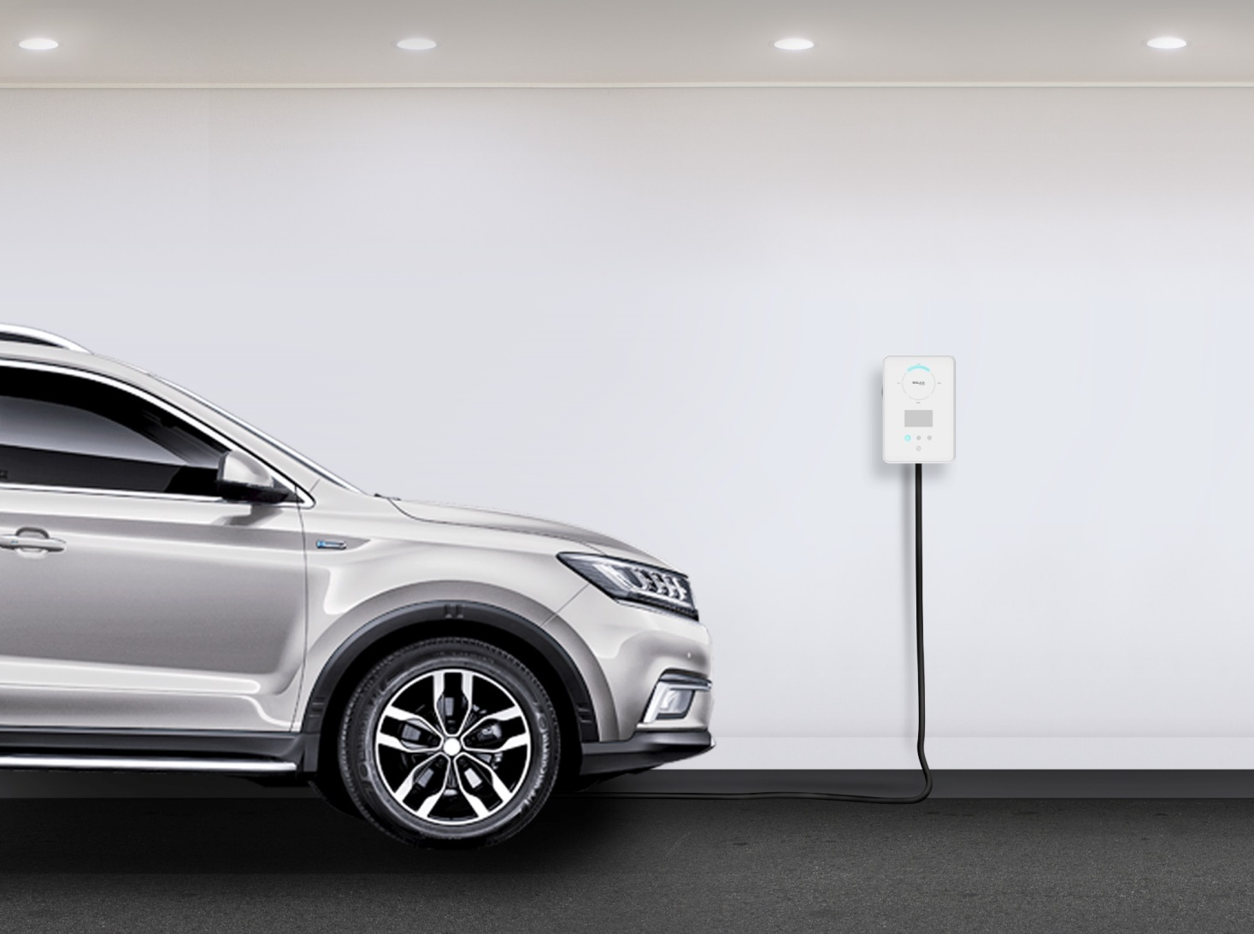
1. Solution Overview
02
SMART EV CHARGER
Work Modes
There are five Work Modes designed for the Smart EV Charger:
GREEN mode, ECO mode, FAST mode, STOP mode and FAULT mode.
Among these five work modes, GREEN mode, ECO mode, and FAST mode are three charging modes.

Slide 8
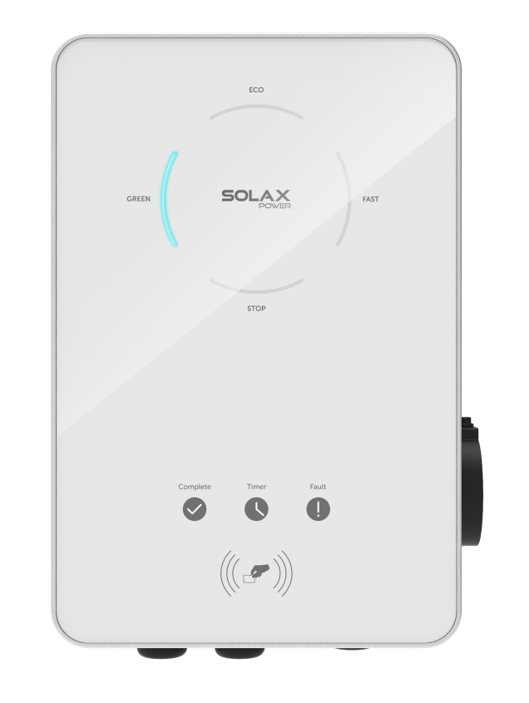
1. Solution Overview
02
SMART EV CHARGER
GREEN mode
The main purpose of Green mode is to charge the EV with renewable energy as much as possible. The default level is 6A, in which the Smart EV Charger will only start to charge if generating current reaches 6A, and it never take electricity from the grid. While there is another 3A level start to charge if generating current reaches 3A, capable to purchase other up to 3A from the grid. This work mode will spend all its effort to help clients use renewable energy and reduce the cost of buying electricity from the grid.

Slide 9
1. Solution Overview
02
Charge Power (kW)
GREEN mode (6A)
Max. Power
ENERGY FROM PV
Min. Power
Time
Charge Power (kW)
GREEN mode (3A)
Max. Power
ENERGY FROM GRID
ENERGY FROM PV
ENERGY FROM GRID
Min. Power
Time

Slide 10
1. Solution Overview
02
SMART EV CHARGER
ECO mode
ECO mode help users to charge EV use renewable energy as much as possible while staying above the set minimum efficiency. Electricity from the grid will help maintain the set minimum efficiency. A charging current can be set thus control the minimum efficiency. For example, the users set the charging current 16A. If the current from the inverter is only 10A then the rest would be taken from the grid as 6A. If the current from the inverter is 18A, then the Smart EV Charger will output 18A.

Slide 11
1. Solution Overview
02
ECO mode (6/10/16/20/25A)
Charge Power (kW)
Max. Power
ENERGY FROM PV
Set Power
ENERGY FROM GRID
Time
Time

Slide 12
1. Solution Overview
02
SMART EV CHARGER
FAST mode
In Fast mode, the Smart EV Charger will output with the maximum current no matter electricity from the inverter or the grid. This mode usually applies to the users who wants to charge their EV as soon as possible or to the area where there are peak and valley price of utility.

Slide 13
1. Solution Overview
02
FAST mode
Charge Power (kW)
Max. Power
ENERGY FROM GRID
ENERGY FROM PV
Time

Slide 14
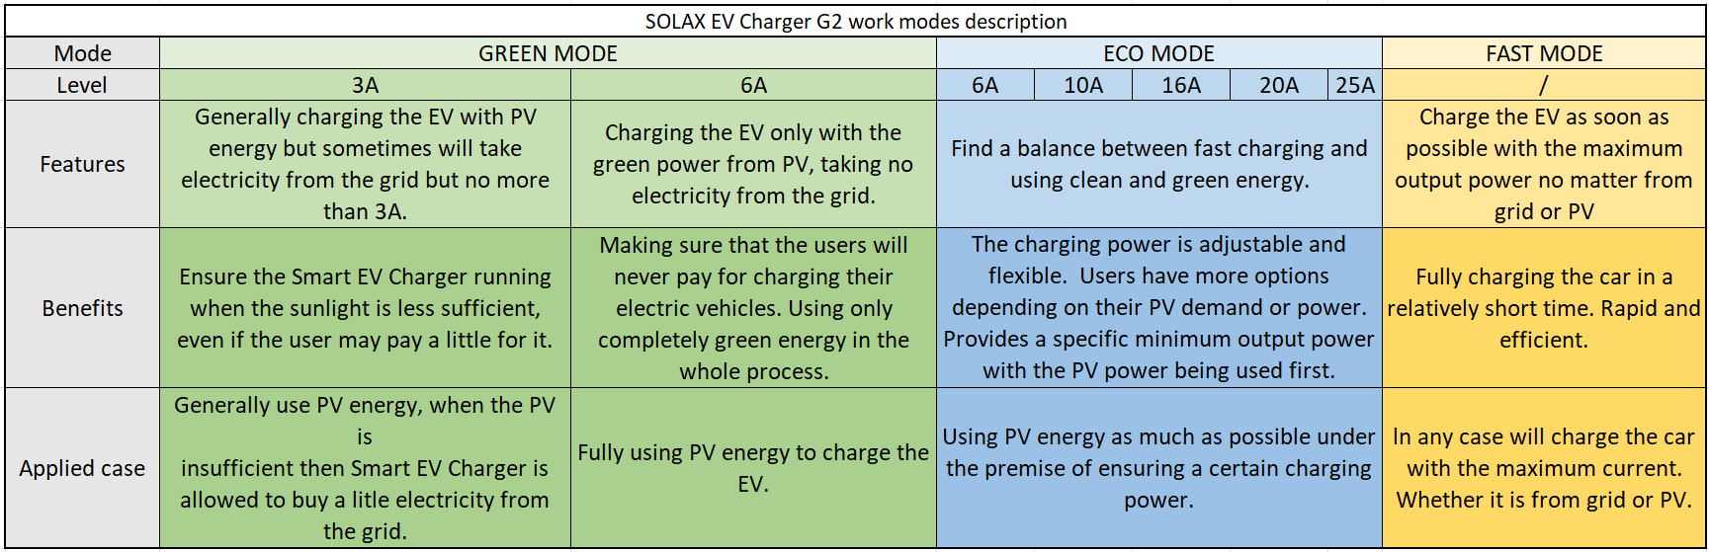
1. Solution Overview
02
Working Modes Comparison

Slide 15
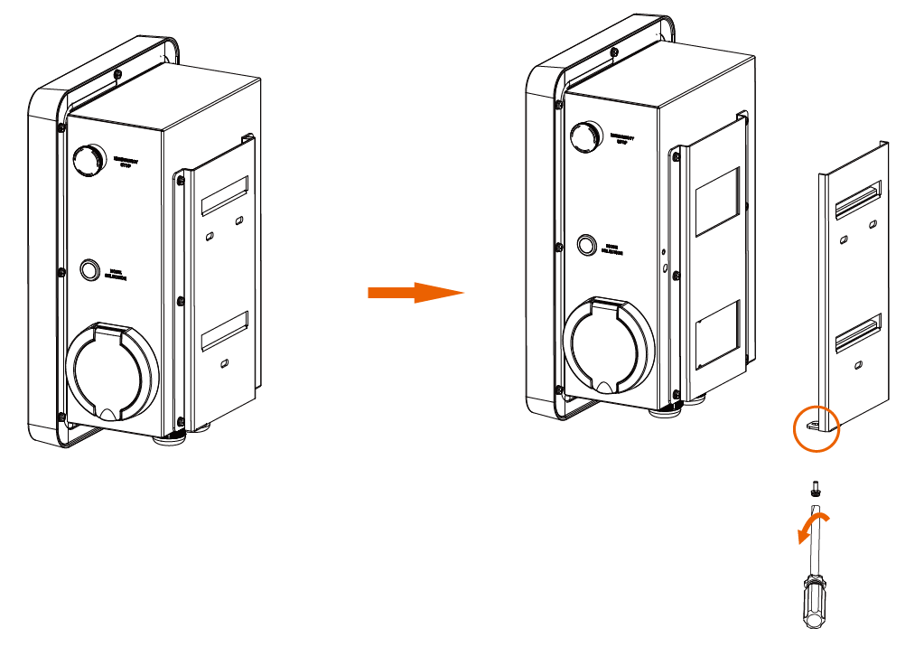
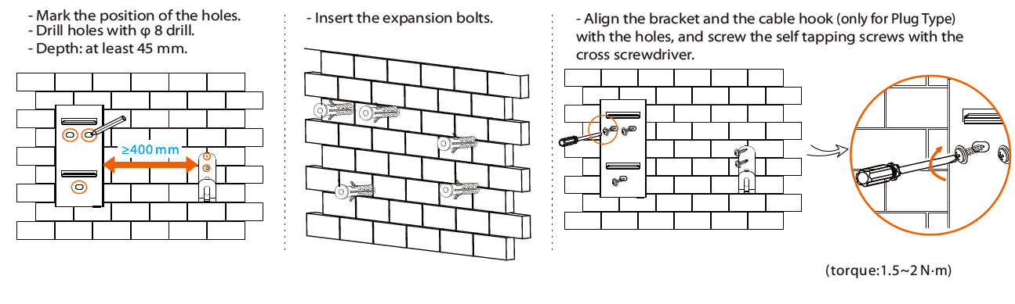
2. Cable Connection – EV Charger
Step 1. Remove the screw from the EV-Charger with the cross screwdriver. Then remove the back bracket away carefully.
Step 2. Fix the back bracket and the cable hook (only for Plug Type) to the wall.

Slide 16
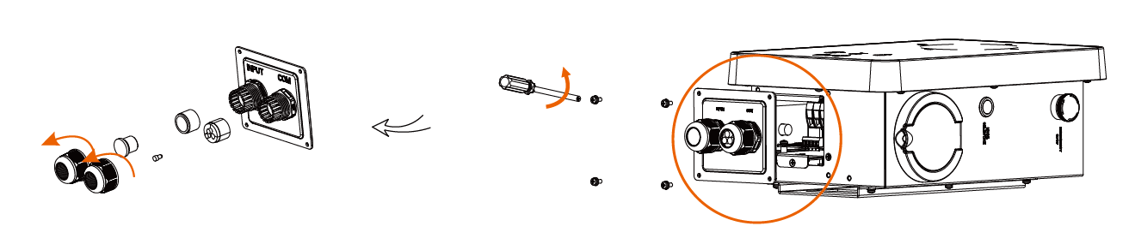
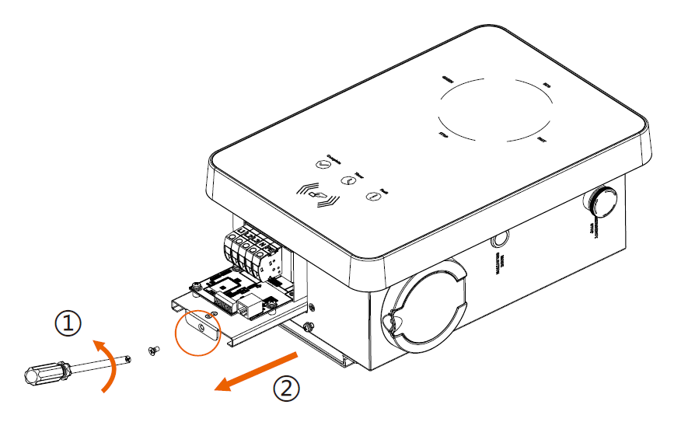
2. Cable Connection – EV Charger
Step 3. Hang the EV-Charger on the wall for trial, then estimate the required length of input cable (three-core for single-phase, five-core for three-phase, outer diameter: 12.5-18 mm) and communication cable. After that, take the EV-Charger down.
Step 4. Unscrew the EV-Charger’s bottom cover with the cross screwdriver and take it down. Then undo the fastening heads and take the waterproof materials away as shown below.
Step 5. Unscrew the countersunk screw of the base plate of communication board with the cross screwdriver. Then pull the base plate of communication board out.

Slide 17
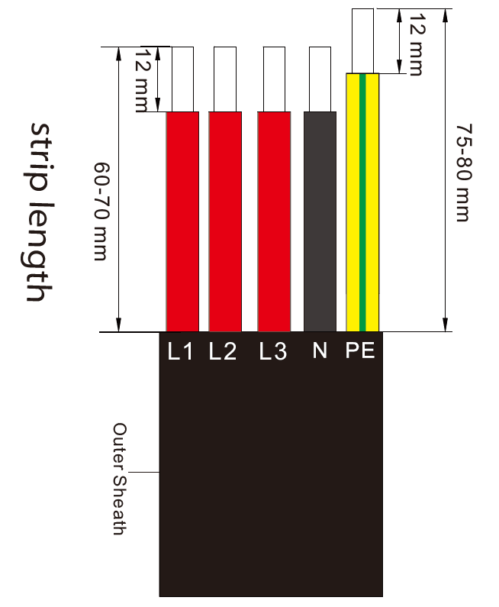
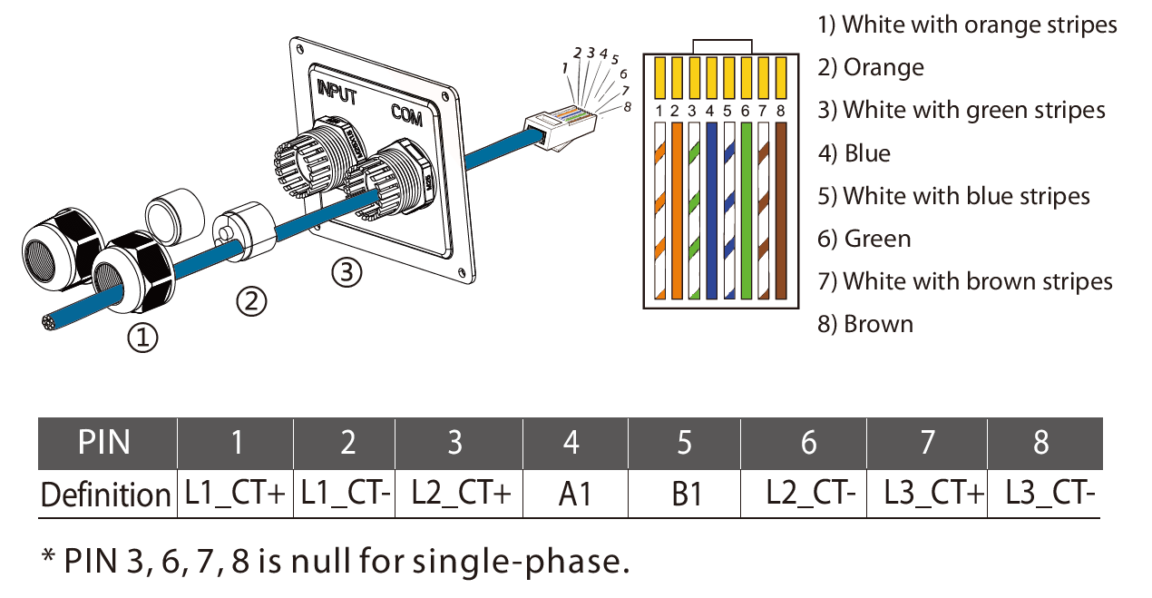
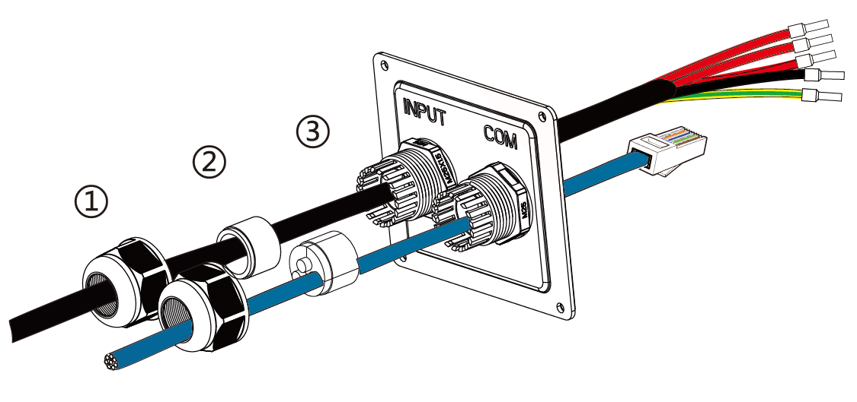
2. Cable Connection – EV Charger
Step 6. Insert the prepared communication cable through the waterproof connector in sequence as shown below (If the cable is self-made, also insert the wires into the RJ45 terminals and then use crimping pliers to press them tightly).
Step 7. Strip the outer sheath of the input cable as below, ensuring all the wires can reach the terminal blocks with a little excessive length. Use the stripping pliers to strip approx. 12 mm of insulation from the end of all the coloured wires as below. Then crimp the European terminal with the wire crimper.
Step 8. Insert the input cable through the waterproof connector in sequence as shown below.

Slide 18
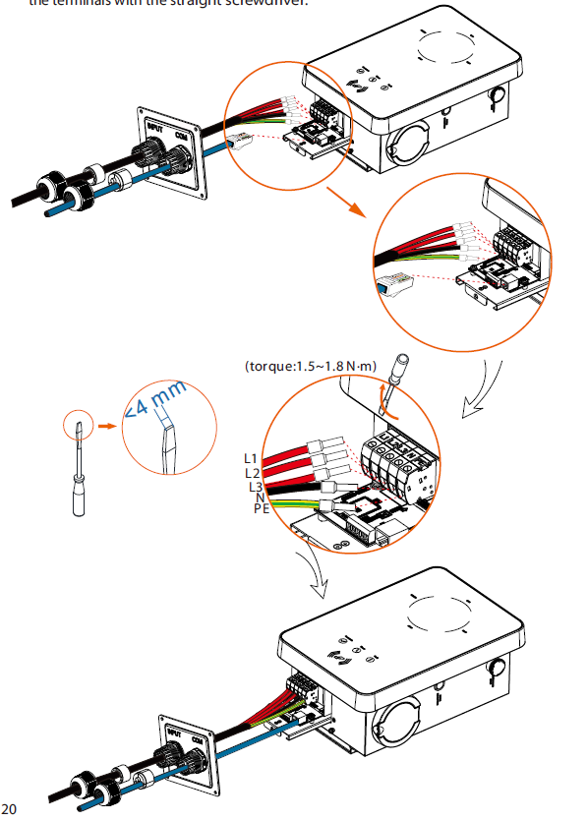
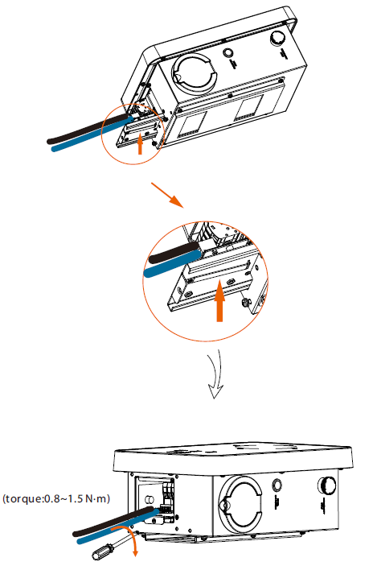
2. Cable Connection – EV Charger
Step 9. Insert the wires into the appropriate holes of the terminal blocks, then block the terminals with the straight screwdriver.
Step 10. Press the spring upward and push the base plate of communication board in. Then screw the countersunk screw.

Slide 19
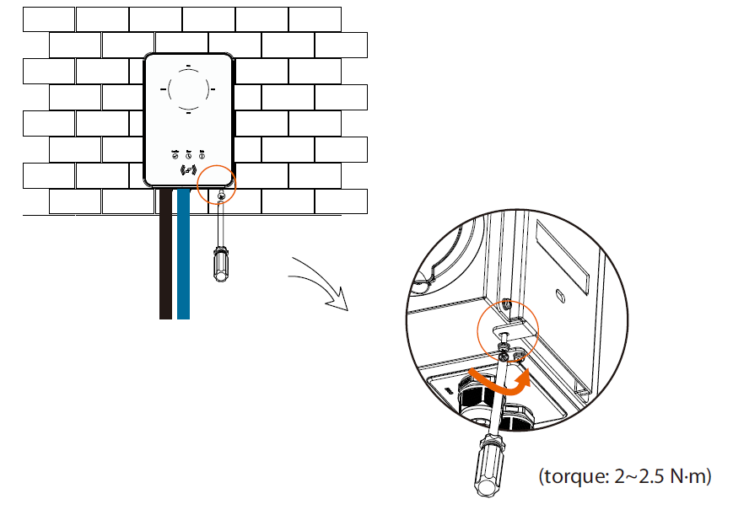
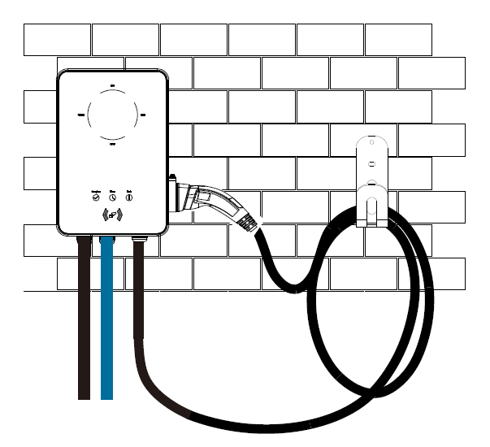
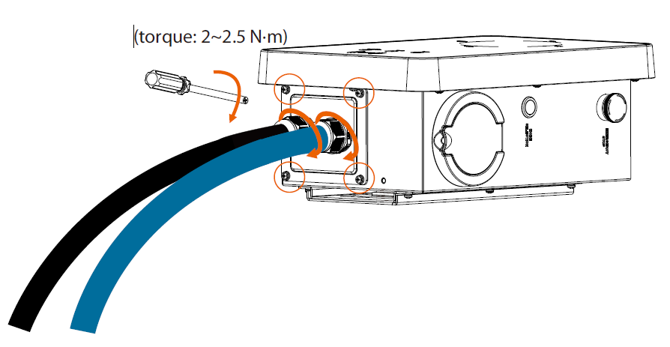
2. Cable Connection – EV Charger
Step 11. Push the rear cover to appropriate position of the cables and screw the self tapping screws with the cross screwdriver. Then tighten the waterproof fastening heads. Hang the EV-Charger up carefully and steady the EV-Charger with the self tapping screw and the cross screwdriver.

Slide 20
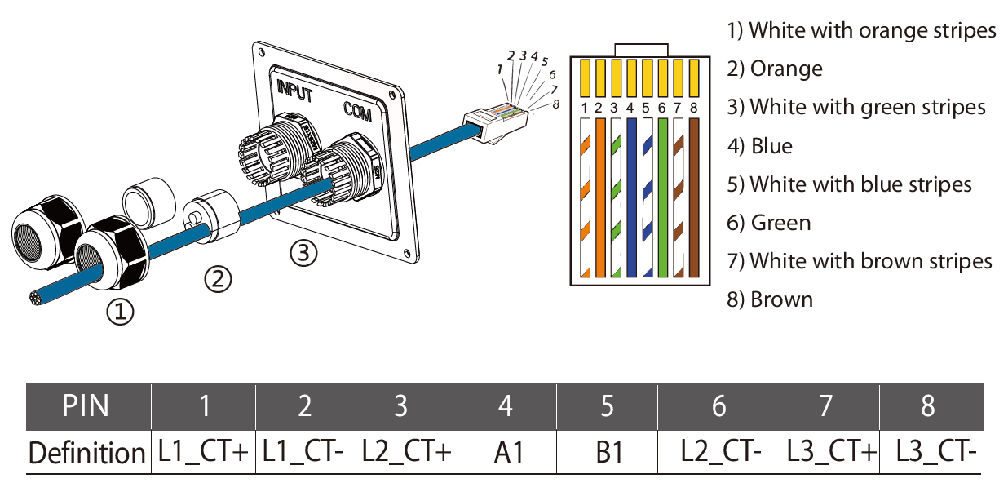
2. Cable Connection – Inverter side
For different inverter models the connection on inverter side is a little bit different.
1. X1-Hybrid G4 & X3-Hybrid G4
For Hybrid G4 and EV charger both of the connections use COM ports.
PIN Definition of EV charger COM port:
PIN Definition of Hybrid G4 COM port:

Slide 21
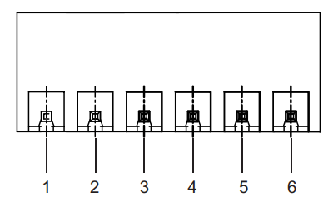

2. Cable Connection – Inverter side
For different inverter models the connection on inverter side is a little bit different.
2. X3-PRO G2
For X3-PRO G2 it uses RS485 port, for EV charger it uses COM port.
PIN Definition of EV charger COM port:
PIN Definition of X3-PRO G2 RS485 port:

Slide 22
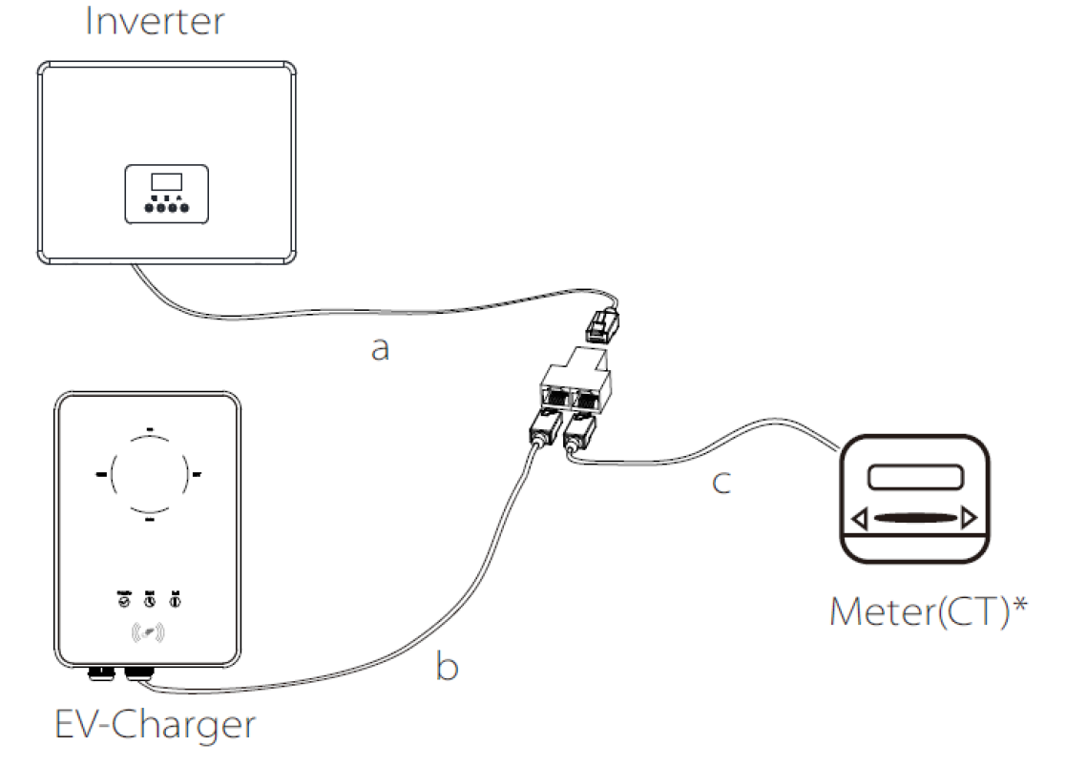
2. Cable Connection – Inverter side
For different inverter models the connection on inverter side is a little bit different.
2. X3-MIC G2, X1-Mini G3/G4 & X1-Boost G3/G4
For these inverters they uses the same PINs as meter connection, for EV charger it uses COM port, so a splitter is needed to connect EV charger and meter to the inverter.
Meter/CT
RJ45 splitter
COM
NOTE: The splitter should be placed in a waterproof place.

Slide 23
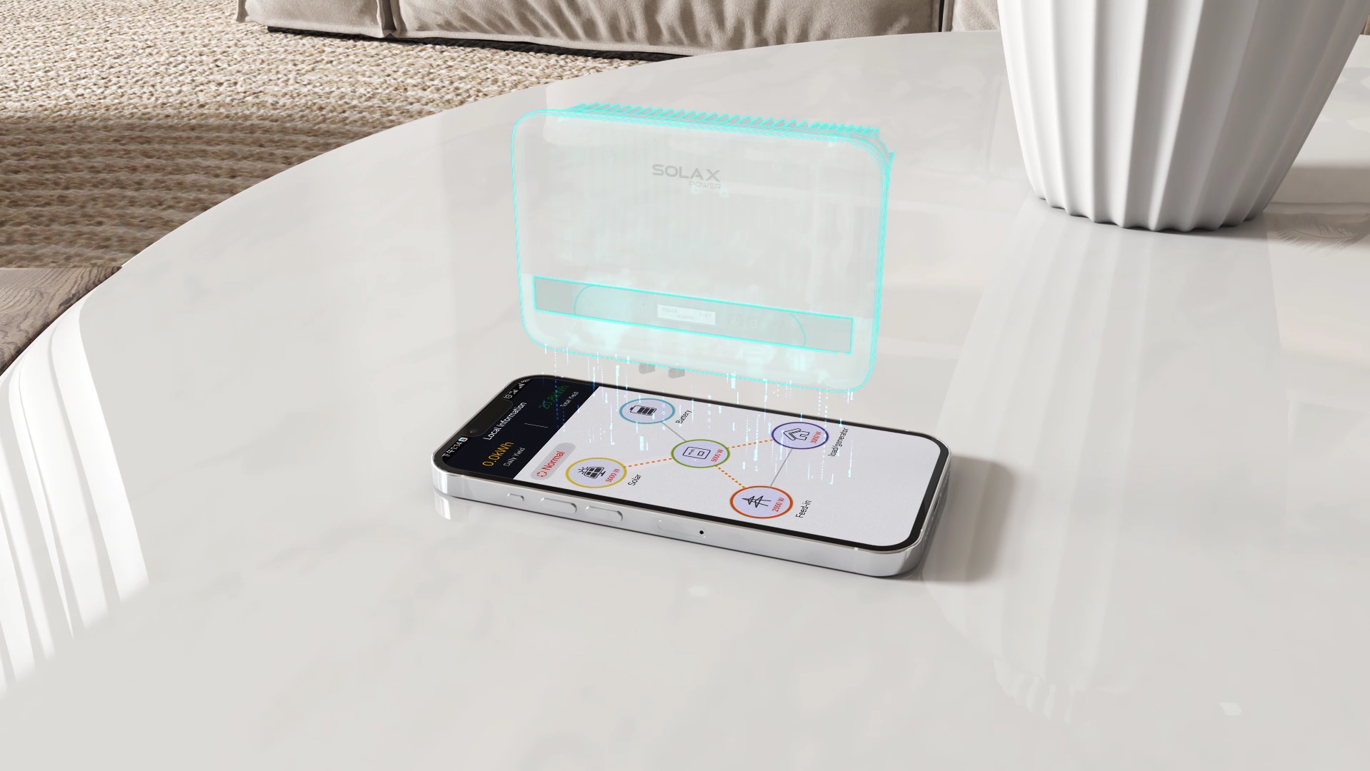
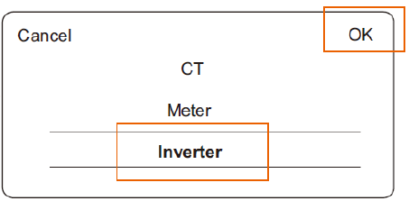
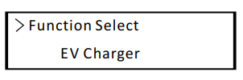
3. System Setting
Main Settings
EV charger:
Advanced setting > Grid Data Source
Inverter setting Hybrid G4:
Advanced setting > Modbus

Slide 24
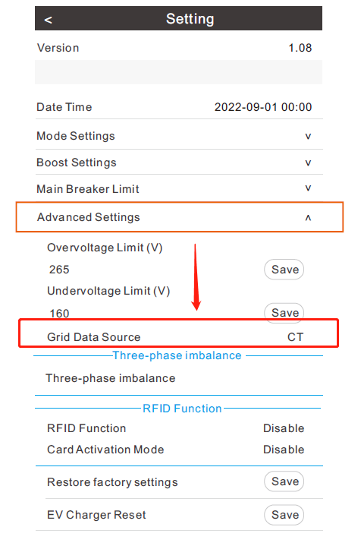
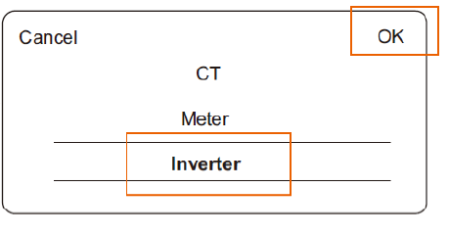
3. Setting and Commissioning
EV Charger Setting
Step 1: Power the EV charger, follow the instructions in the user manual to download the APP, complete the Wi Fi connection and login.
Step 2: Select "Advanced Settings" and set the "Grid Data Source" as "Inverter" touch "OK" to confirm. The buzzer of the EV Charger will beep after the setting is succeeded.

Slide 25
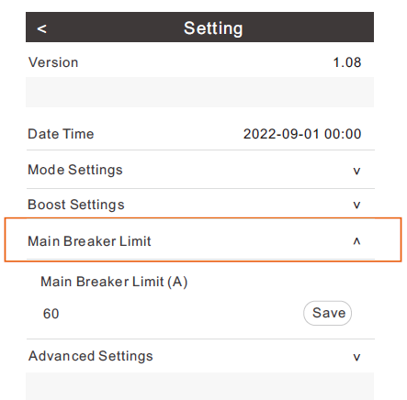
3. Setting and Commissioning
EV Charger Setting
Step 3: Select “Main Breaker Limit” and set the value. With the dynamic load balance function, when the power consumption approaches the preset max value, the EV-Charger will reduce charge power so that the main breaker current will reduce to the preset value minus 5A, thus avoid the situation of main breaker trip due to overload.

Slide 26
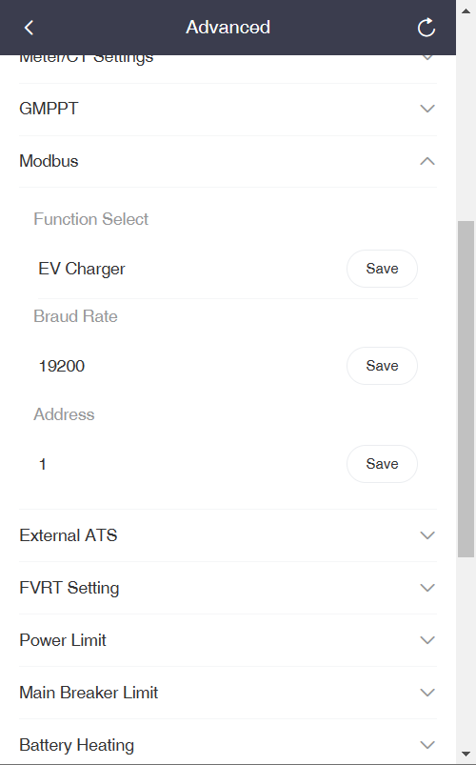
3. Setting and Commissioning
Inverter Setting
Step 1: On the Hybrid inverter, go to menu>advanced setting>Modbus
Step 2: For “Function Select”, change to “EV Charger” and save.
NOTE: The EV-Charger function and the parallel system with Datahub cannot be used at the same time currently.

Slide 27
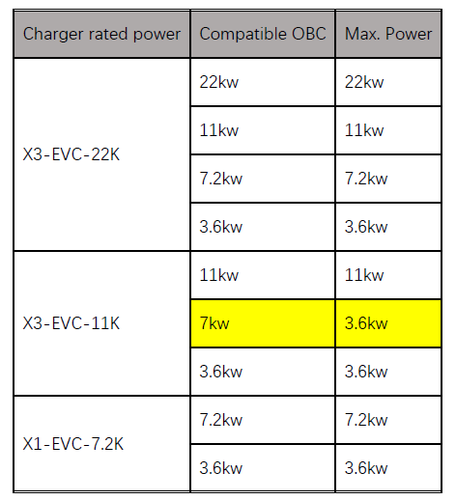
4. Installation Tips
For OBC (On-board charger) compatibility with SolaX EV charger, please refer to the following chart.
When the EV charger is used as standalone solution, the inverter can be any other 3rd party models.

Slide 28
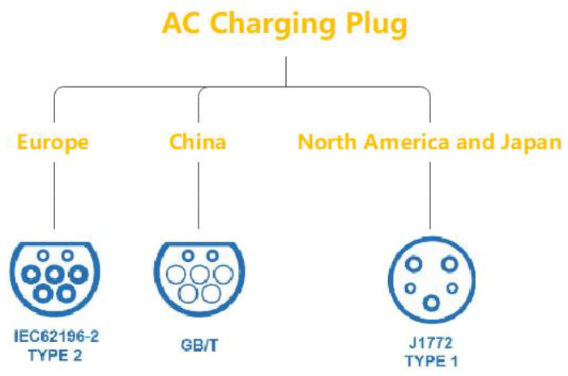
4. Installation Tips
SolaX EV charger is compatible with the first two plug types in the picture, the third one compatibility is in development.
Currently
Supported
EV-Charger(home version) has two start-up patterns, plug&charge and card-swiping. The plug & charge pattern is the default, and the card-swiping pattern needs to enable the “RFID Function” in the APP advanced settings.
Hybrid parallel system can also work with EV chargers, just set the EV charger on the master inverter.

Slide 29



THANK YOU
www.solaxpower.com info@solaxpower.com

